Slide 1

UOFL Basketball Team Project
Team Ace

Slide 2
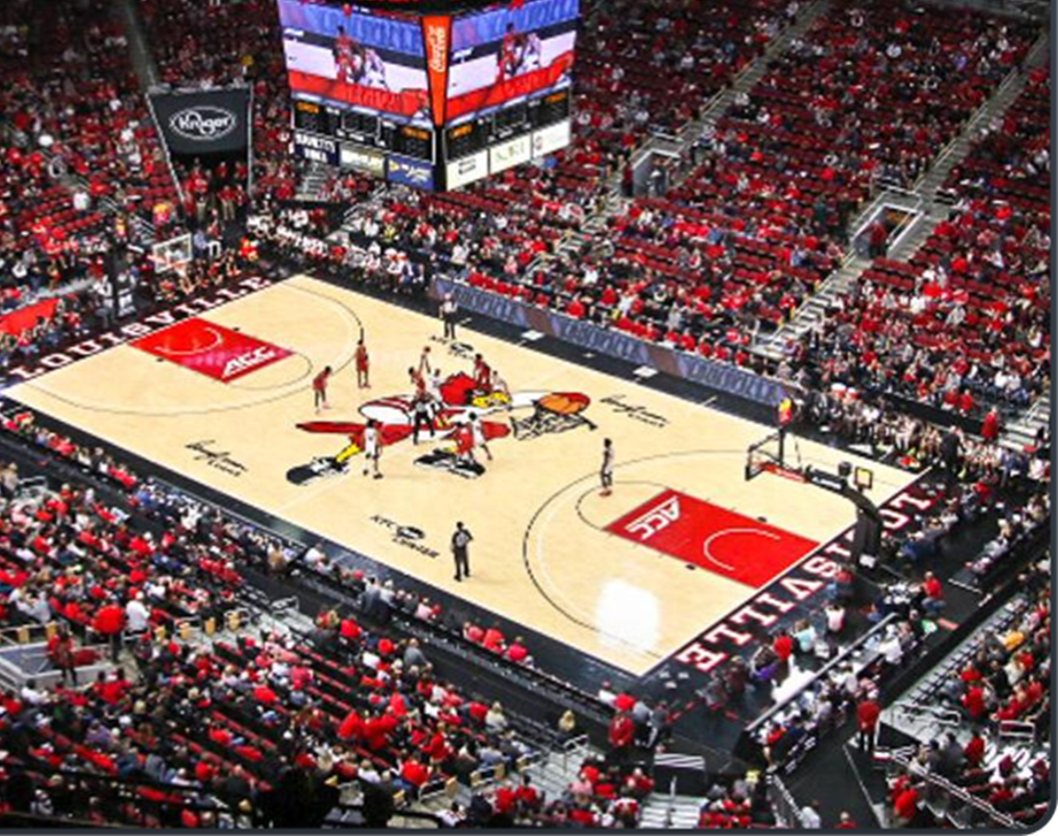
Agenda
Introduction
Our Process
Product Features
Entity Relationship Diagram
Cost Benefit Analysis
Prototype

Slide 3

Introduction
•Problem: The basketball teams needs a centralized secure database and website that serves as a hub for all of the data the team needs.
•Our Solution: Design a website that will serve as a hub for all the teams needs. It will contain everything the coaches, players, and staffs need.

Slide 4
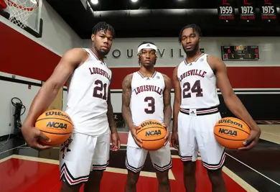
Our Process
Researched cost-effective ways to create a secure centralized database and website
Created prototype pages for the website
Created a relational database to illustrate the system's functions
Received feedback from Professor Hatami and Justin and made changes according to their feedback.

Slide 5
Product Features
Player Page
System requirement: The player page will allow player information to be edited.
Use Case: Nutritionist updates Player nutrition plan.
Actor: Nutritionist
Description: Nutritionist can upload nutrition plan for player to the website.
Risk Level: Medium.
Event Page
System requirement: The event page will allow information to be edited.
Use Case: Edit Event
Actor: Administrator
Description: An event needs to be edited.
Risk Level: Medium.
Help Page
System requirement: The help page will allow for users to be redirected to a dedicated help desk team.
Use Case: Speak to a Help Desk Representative
Actor: Coach or Nutritionist
Description: A coach or nutritionist needs to speak to a help desk representative.
Risk Level: Low.

Slide 6
Product Features
Log In Page
System requirement: The login page will authenticate the user and their access level.
Use Case: Coach logs in from Home Device.
Actor: Coach.
Description: Coach logs in from home device to view a player's profile.
Risk Level: High
Home Page
System requirement: The home page will allow announcements/multimedia to be posted.
Use Case: Create New Post in Feed.
Actor: Administrator.
Description: Practice update needs to be posted for players to view.
Risk Level: Medium.
Previous Game
System requirement: The previous game page will allow previous game film to be uploaded
Use Case: Coach views Game Film.
Actor: Coach.
Description: Coach wants to review and analyze previous game film.
Risk Level: Medium

Slide 7
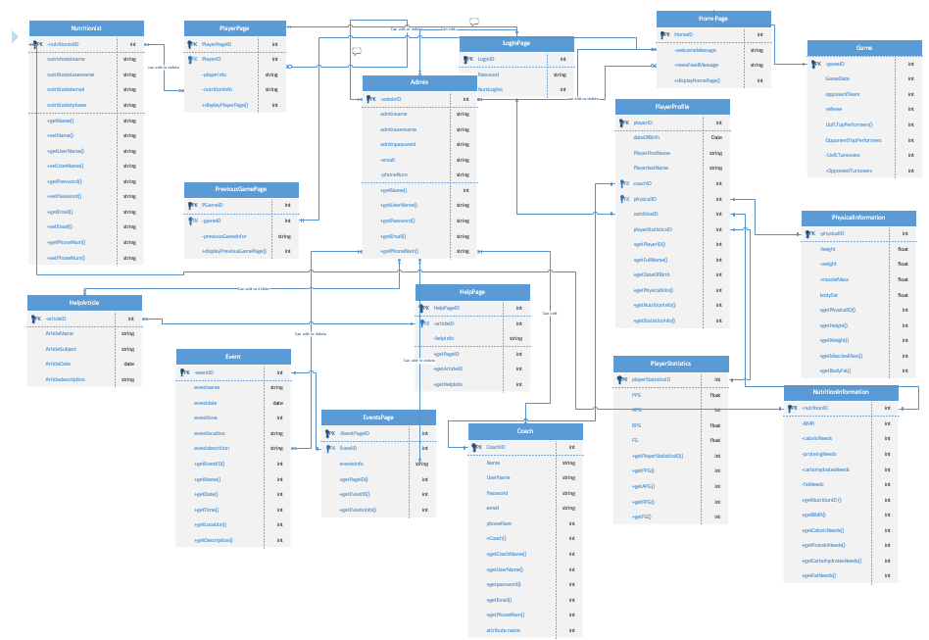
Entity Relationship Diagram

Slide 8
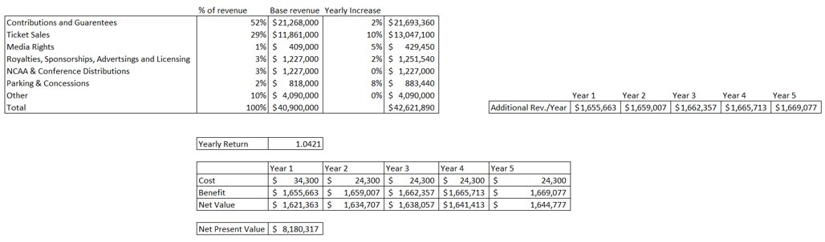
Cost Benefit Analysis

Slide 9
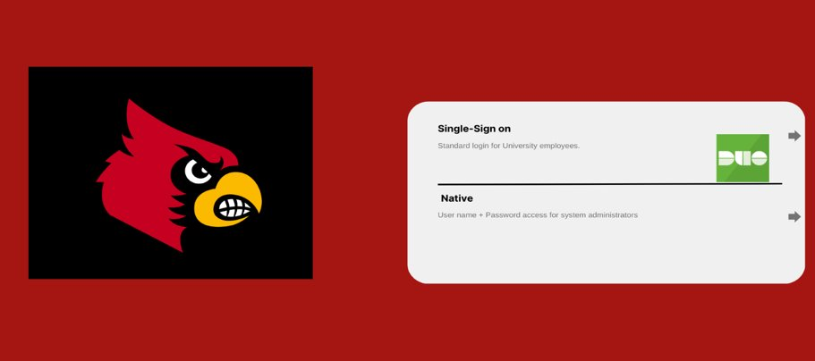
Prototype: Login Page

Slide 10
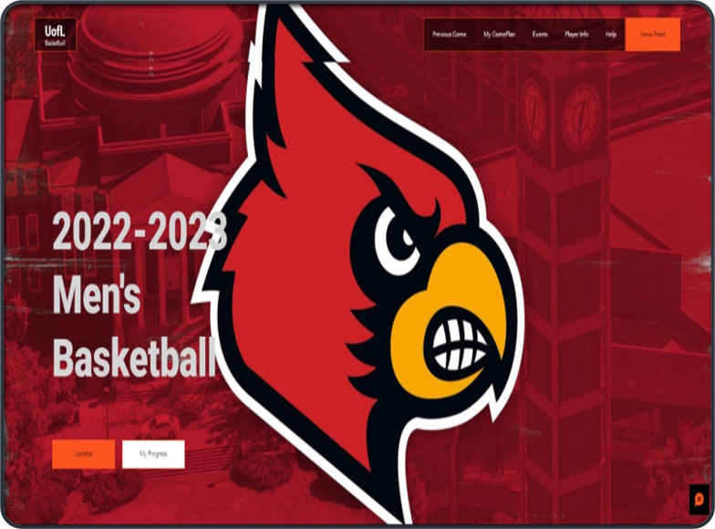
Prototype: Home Page

Slide 11
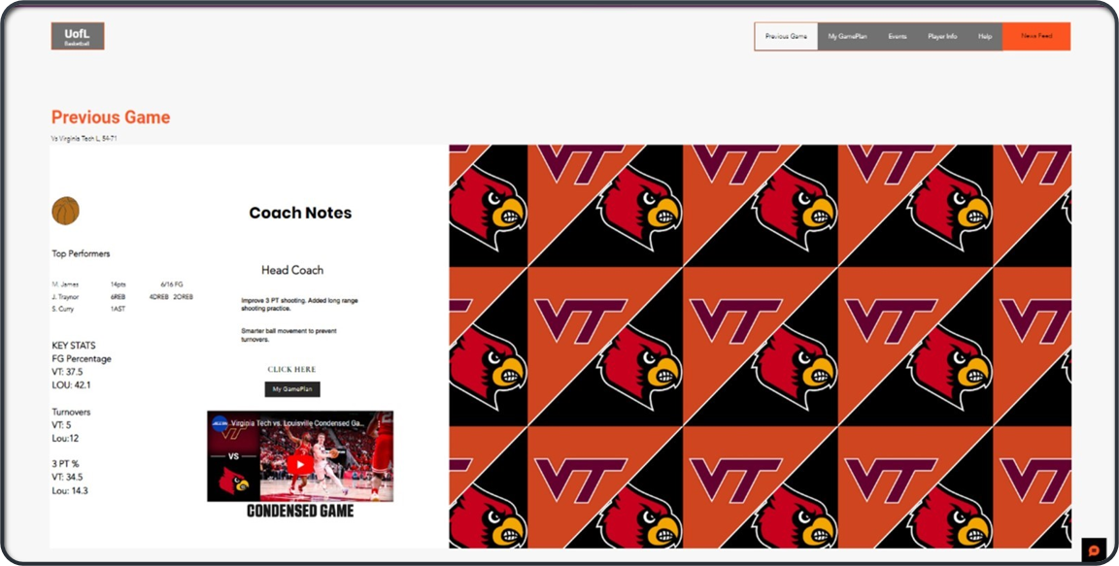
Prototype: Previous Game Page

Slide 12
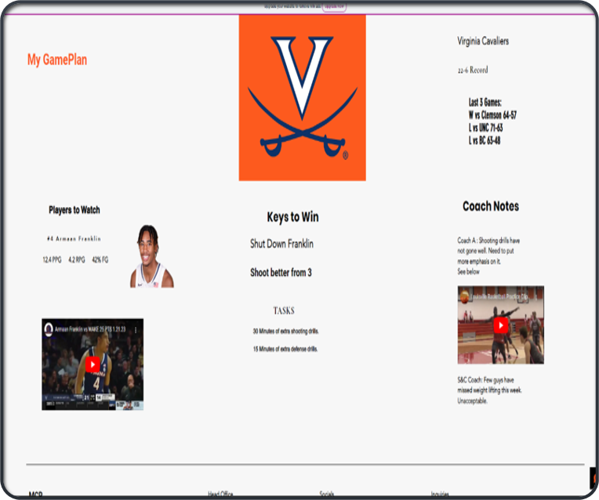
Prototype: Current Game Page

Slide 13
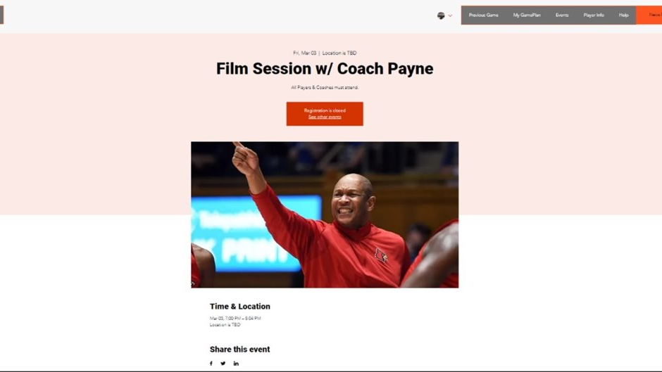
Prototype: Event Page

Slide 14
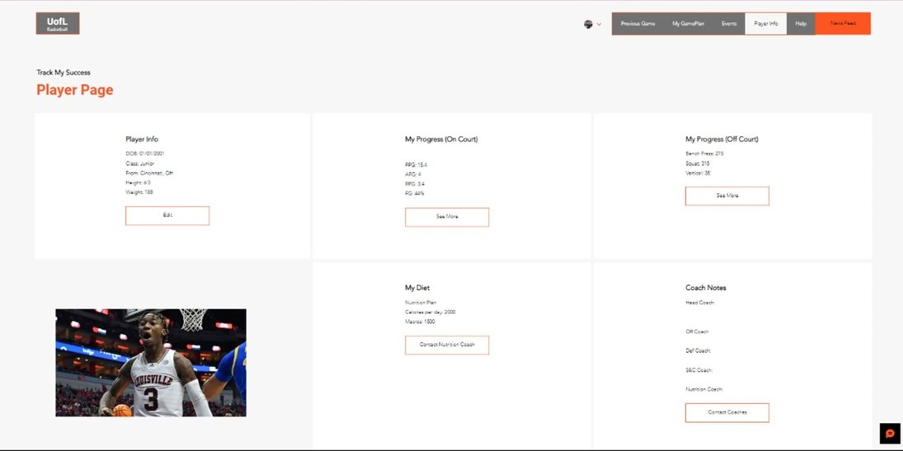
Prototype:Player Page

Slide 15
Conclusion
The UofL basketball teams needs a secure centralized database and website that can be accessed anywhere and on the go.
In order to give our basketball team a higher success rate of winning, we need to have the best up to date data on them, in order to help them perform at their highest level.
This all starts with having a great website that can be easily accessed, easily navigated, and can be easily understood.
This is what makes our website stand out from the rest, it can be accessed anywhere securely, it can be easily navigated, and easily understood because of our simple design.
Remember, it is our responsibility to give our athletes the highest chance to succeed! That is what It means to be a supporting staff!

Slide 16

Questions?

